Slide 1
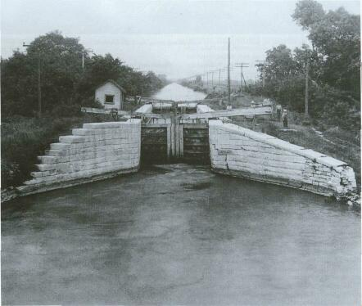
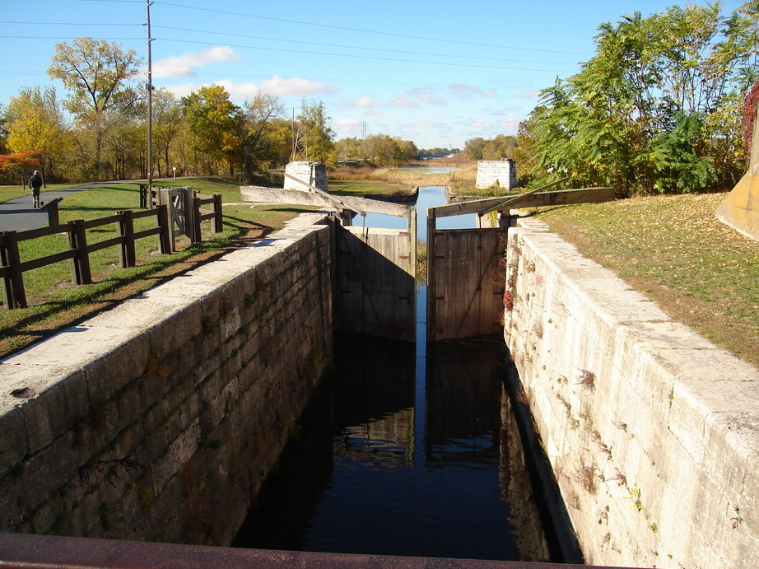
Illinois & Michigan Canal
A brief History

Slide 2
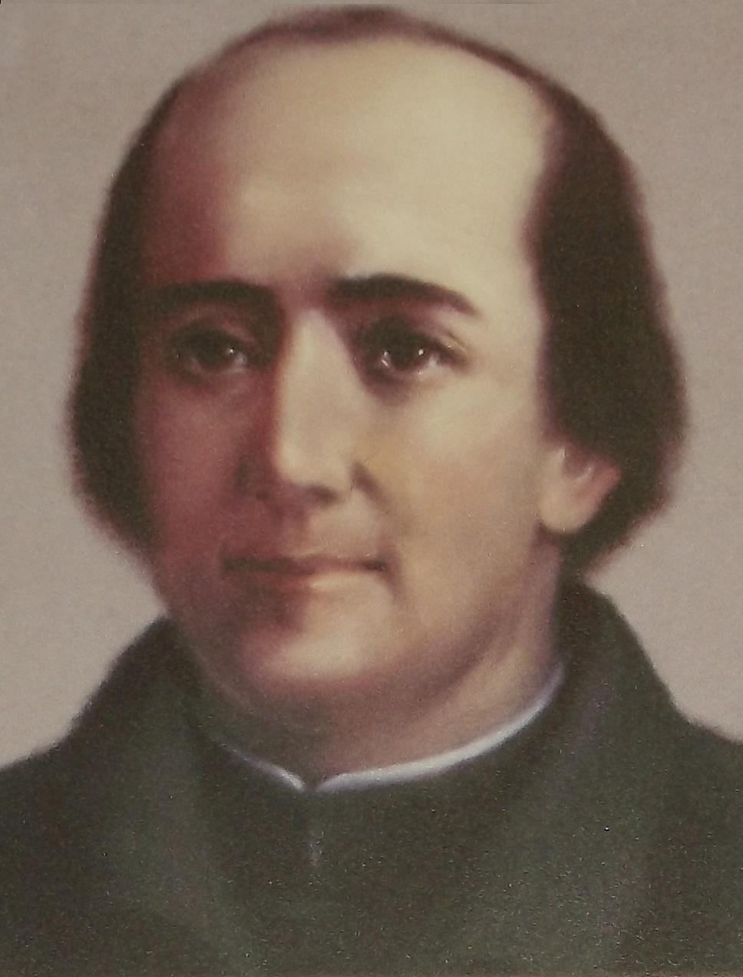
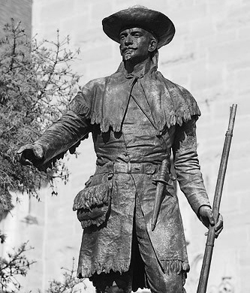
Early Visions
Jacques Marquette
Louis Joliet
In 1673 French explores Jacques Marquette and Louis Joliet set out from Quebec to explore the American Midwest. They traveled by canoe along various rivers.
Upon their return Joliet wrote that the Atlantic Ocean could be connected to the Gulf of Mexico if a canal was built to connect Lake Michigan to the Illinois river.
The French never acted on Joliet's vision and the canal would not be built for over 150 years.

Slide 3
United States Takes Control
In 1783 the area which is now Illinois became part of the United States, although Native Americans still lived on the land.
In 1807 a land survey concluded that a canal should be built through the Chicago Portage, the area where goods had to be carried over land to reach Lake Michigan.

Slide 4
United States Takes Control (continued…)
1816 Land concessions by Native Americans made building a canal along this route more plausible.
1818 Illinois becomes a state. The original state northern border was to be placed at the Southern tip of Lake Michigan. It was moved North 50 miles so that the canal could be built in one state. If this had not happened Chicago would be in Wisconsin!

Slide 5
Becoming a Reality
In the 1820’s the federal government granted to Illinois the necessary land along the route to create the canal.
1829 A Canal Commission was created and began land sales to raise funds for the canal.
In 1833 the Illinois General Assembly abolishes the Board of Canal Commissioners and abandons the proposed I&M Canal due to lack of funds.
1835 Illinois General Assembly establishes another Board of Canal Commissioners with the authority to generate funds to complete construction of the proposed I&M Canal.

Slide 6
Document authorizing the appropriation of land to the State of Illinois for the purpose of constructing a canal. The act was passed by congress in 1927 and signed by president John Quincy Adams.

Slide 7
Construction Begins
1836 The town of Lockport is chosen as the administrative headquarters of the I&M Canal.
Work began in 1836. The rights to build the canal were awarded to different contractors throughout the route.
This meant that building the canal was not a uniform effort, different people were in charge of different sections.

Slide 8
Trouble in Paradise
In 1837 there is a national depression, work continues though.
1840-1844 most work on the canal stops because of a lack of funds.
1843 one way the canal was funded was through inviting public investment. Bonds were sold, and those that purchased these bonds would get back their investment with interest. But due to a lack of funds, the Canal Commission pledged land and revenues from canal until the principal and interest was paid on these loans. Illinois does not regain control of the canal once bondholders are paid off in 1871.
1845 construction resumes as funding is secured from new investors, including those from England and France.
1848 canal is completed and The Chicago Board of Trade is founded to handle increases in shipments of grain.

Slide 9
Completion of the Canal
1848 canal is completed and The Chicago Board of Trade is founded to handle increases in shipments of grain.
The canal was 96 miles long, beginning in Bridgeport and ending in Peru
6 feet deep and 60 feet wide
It had 15 locks and 4 aqueducts

Slide 10
This painted depiction of the I&M Canal showing a mule team, canal boats and a lock

Slide 11
After Completion
Canal is instrumental in growing both Chicago and the surrounding. communities
Chicago population quintupled between 1848 and 1860.
Canal was a key shipping route for goods such as grain wheat.
Canal opened up new markets in the East and South for Midwest farmers.

Slide 12
After Completion Continued
Passengers travelled by boat along the canal until 1853 as railroads became more popular.
Shipping remained strong and did not peak until 1883 because cost was much lower than railroad costs.
1 million tons of goods were shipped along the canal in 1883.
Canal played a vital role in keeping the union army fed during the civil wa.r
This was the most profitable time period for the canal due to the war.

Slide 13
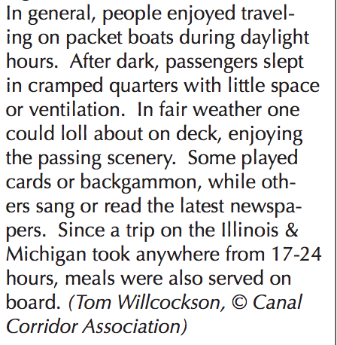

Slide 14
The End of the Working Canal
1900 On January 17,the Chicago Sanitary and Ship Canal opens between Chicago and Lockport, reversing the flow of the Chicago River, sending sewage from Chicago to the Des Plains River, and diverting barge traffic from the I&M Canal.
1910 The northernmost section of the I&M Canal between Chicago and Lockport is permanently closed to traffic.
1933 The Illinois Waterway, a series of locks and dams that regulate the Illinois River at a depth of 9 feet, opens and the LaSalle-Joliet section of the I&M Canal officially closes.

Slide 15
The Canal in Retirement
1933-1938 The CCC creates walking trails along the canal, installs boat docs, and plants trees and shrubbery.
Becomes a state park in 1955.
1984 Congress passes a bill authorizing the creation of the Illinois & Michigan Canal National Heritage Corridor. President Reagan signs the bill into law creating the first national heritage corridor in the country!
Currently the I&M Corridor Association manages the canal from LaSalle Illinois.

Slide 16
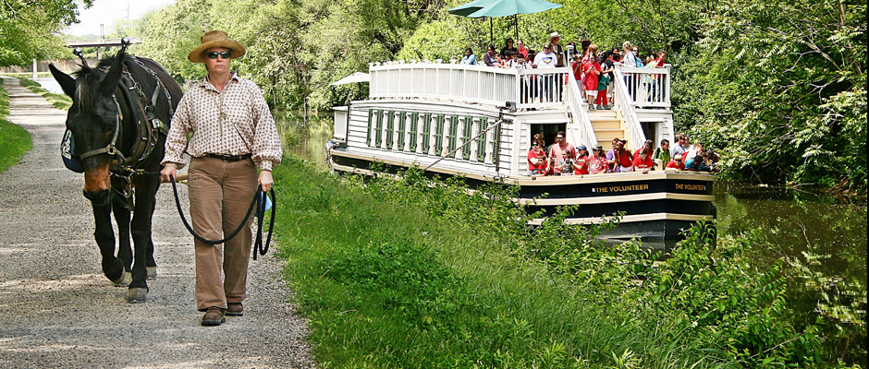
Canal Corridor Association
Currently the I&M Corridor Association manages the canal from LaSalle Illinois
For information about the canal, trails, boat rides, and more visit their website
http://canalcor.org/

Slide 17
The Canal And Labor

Slide 18
Songs About the Canal
Song about canal creation

Slide 19
Digging the Canal
The canal was to be 96 miles long, 6 feet deep, and 60 feet wide
It had 15 locks and 4 aqueducts
To build this workers were given a shovel, a wooden scoop and a wheelbarrow.
There was no motor powered machinery!
They often worked 12 hour days

Slide 20
Who Were the Workers?
Most workers were Irish immigrants who had previously worked on other canal projects in the east
Other nationalities included but were not limited to German and Dutch
Many traveled to work on the projects alone although some laborers brought their families

Slide 21
How were they paid?
They were promised one dollar a day
Employers also provided whiskey to the Irish workers
This was considered a medicine for the difficult manual labor
Once the canal project was low on funds, workers were paid in scrip
A $1 scrip was worth much less than an actual dollar

Slide 22
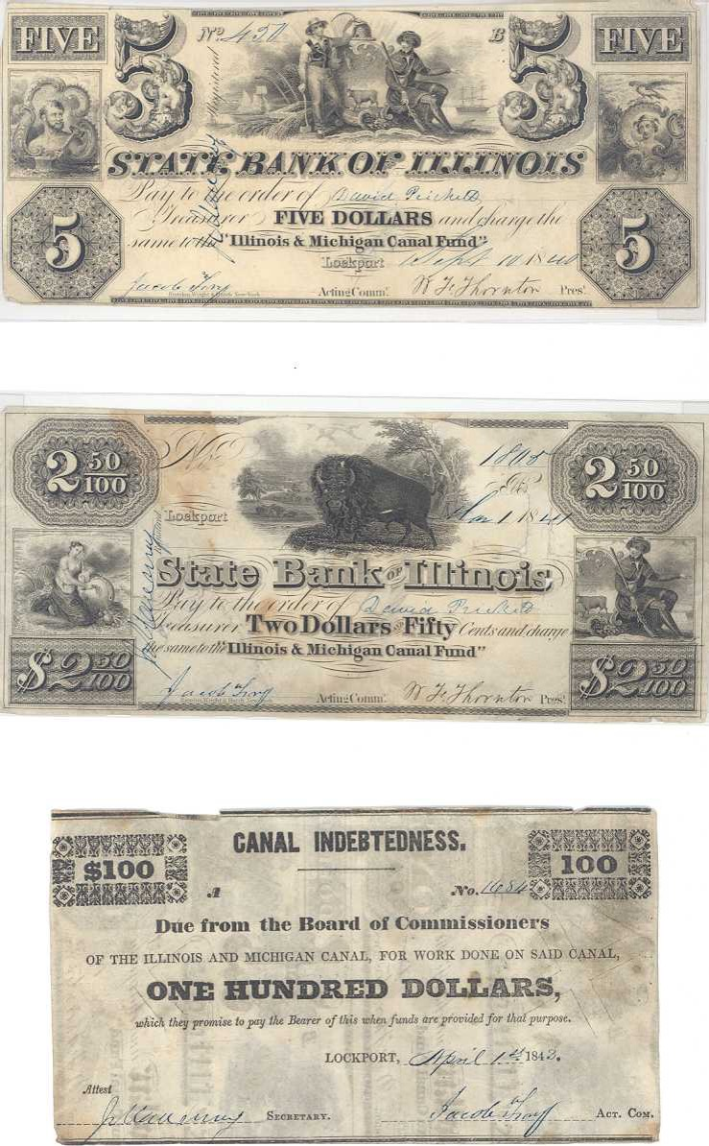
Copies of the scrip used to pay the workers of the I&M canal

Slide 23
Life Building the Canal
The workers lived in temporary communal housing set up along the canal path.
Fighting occurred regularly between different groups of people.
There was a rivalry between the “Corkonians” (Catholic Irish) and the “Fardowners” (Protestant Irish).
One clash even resulted in deaths when a separate town posse intervened with rifles.

